Slide 1

EU Testing and Experimentation Facility for Health AI and Robotics (TEF-Health)
04 Dec 2025
Prof. Dr. Petra Ritter
Director International Affairs, Charité
Director Brain Simulation Section BIH & Dept. Neurology, Charité
Coordinator TEF-Health

Slide 2

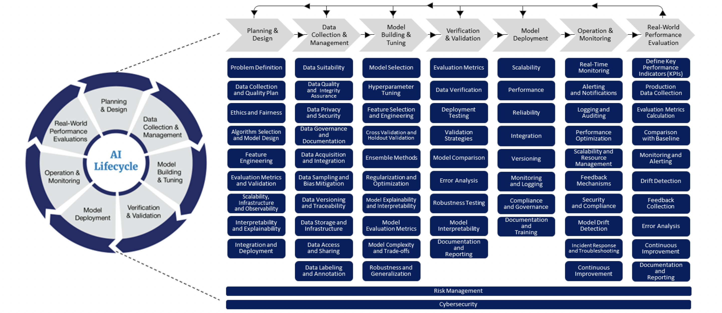
AI Life Cycle

Slide 3
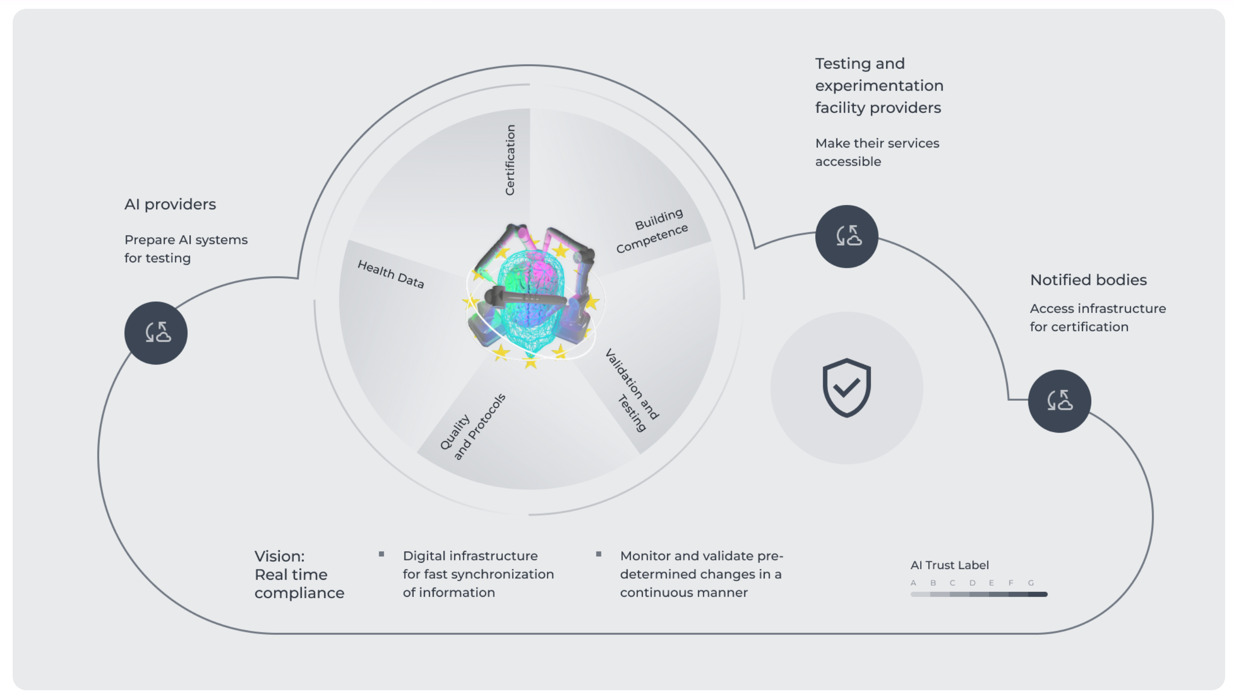
Digital Marketplace
Connect
AI and robotics healthcare product providers with
Testing and validation service providers

Slide 4





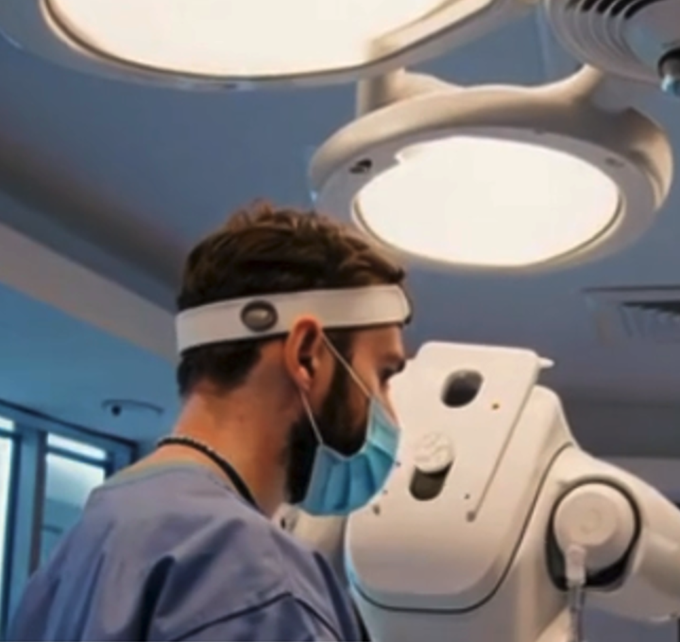

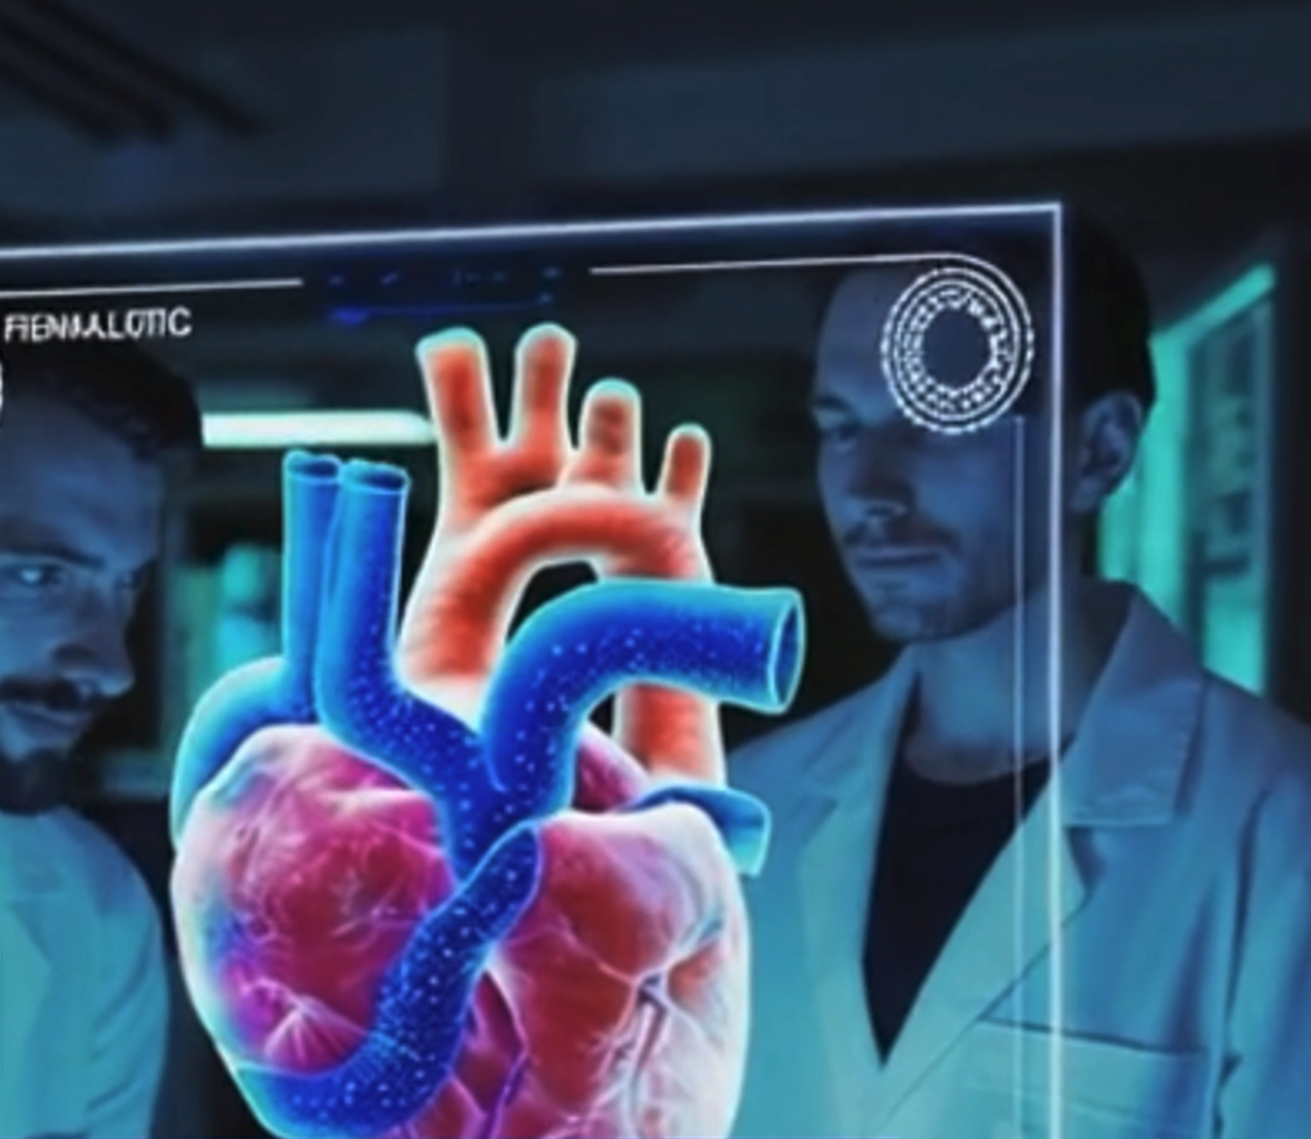
TEF-Healht Services
Consulting
Usability
Testing
Regulatory
Framework
Data
Access

Slide 5
Single EU-wide
entry point through
www.tefhealth.eu
Flywheel to market
Certification
Lab
Idea
Research
Testing
Certification
Bed
Marketable product
Data, Knowledge
Data driven innovation and validation
Health Data
Quality & Regulation
Building Competence
360
Services
ESFRI
Validation & Testing
2
Open Calls
for Discounts
Sustainability

Slide 6
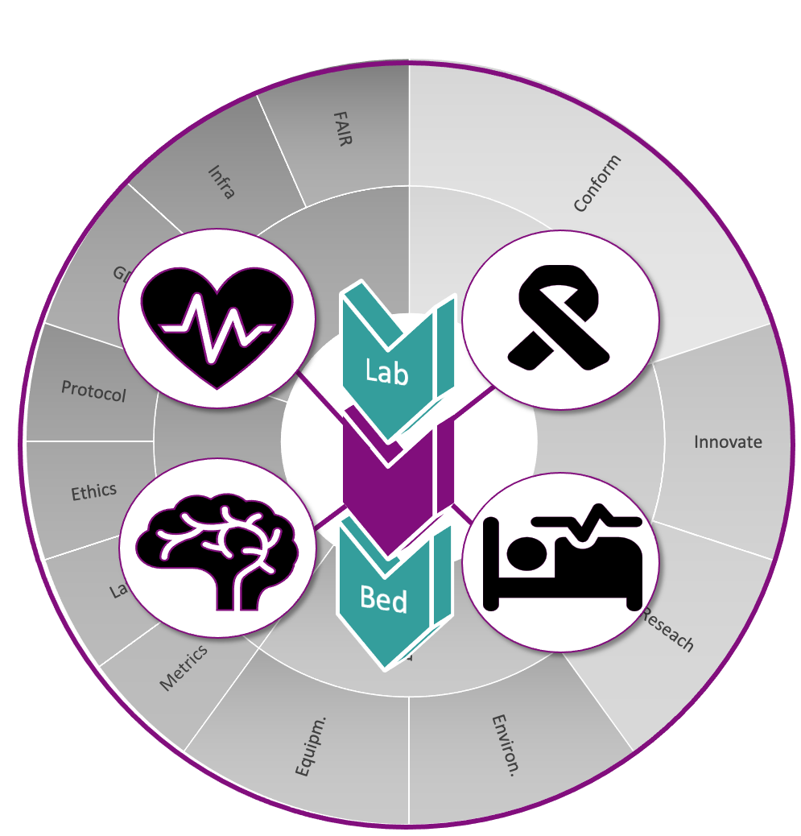
Support for Health Products of Multiple Disciplines
Service Offerings
360
Contracted Services
68
CE Marking
(at service start)
30%
SMEs
(served companies)
88%
Cross-Member State
(service provider and customer MS differ)
33%

Slide 7



Success stories

Slide 8

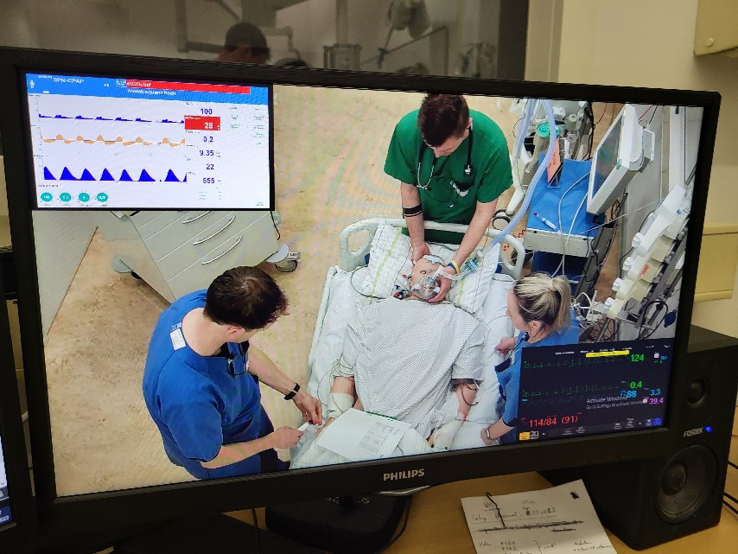
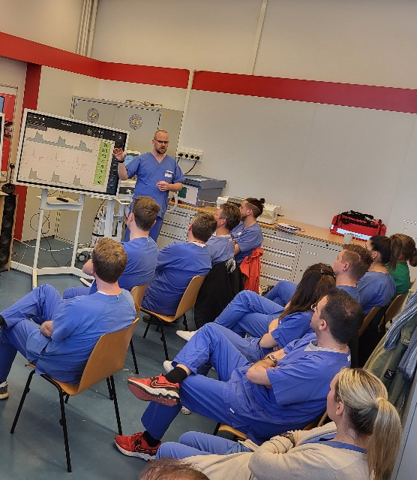
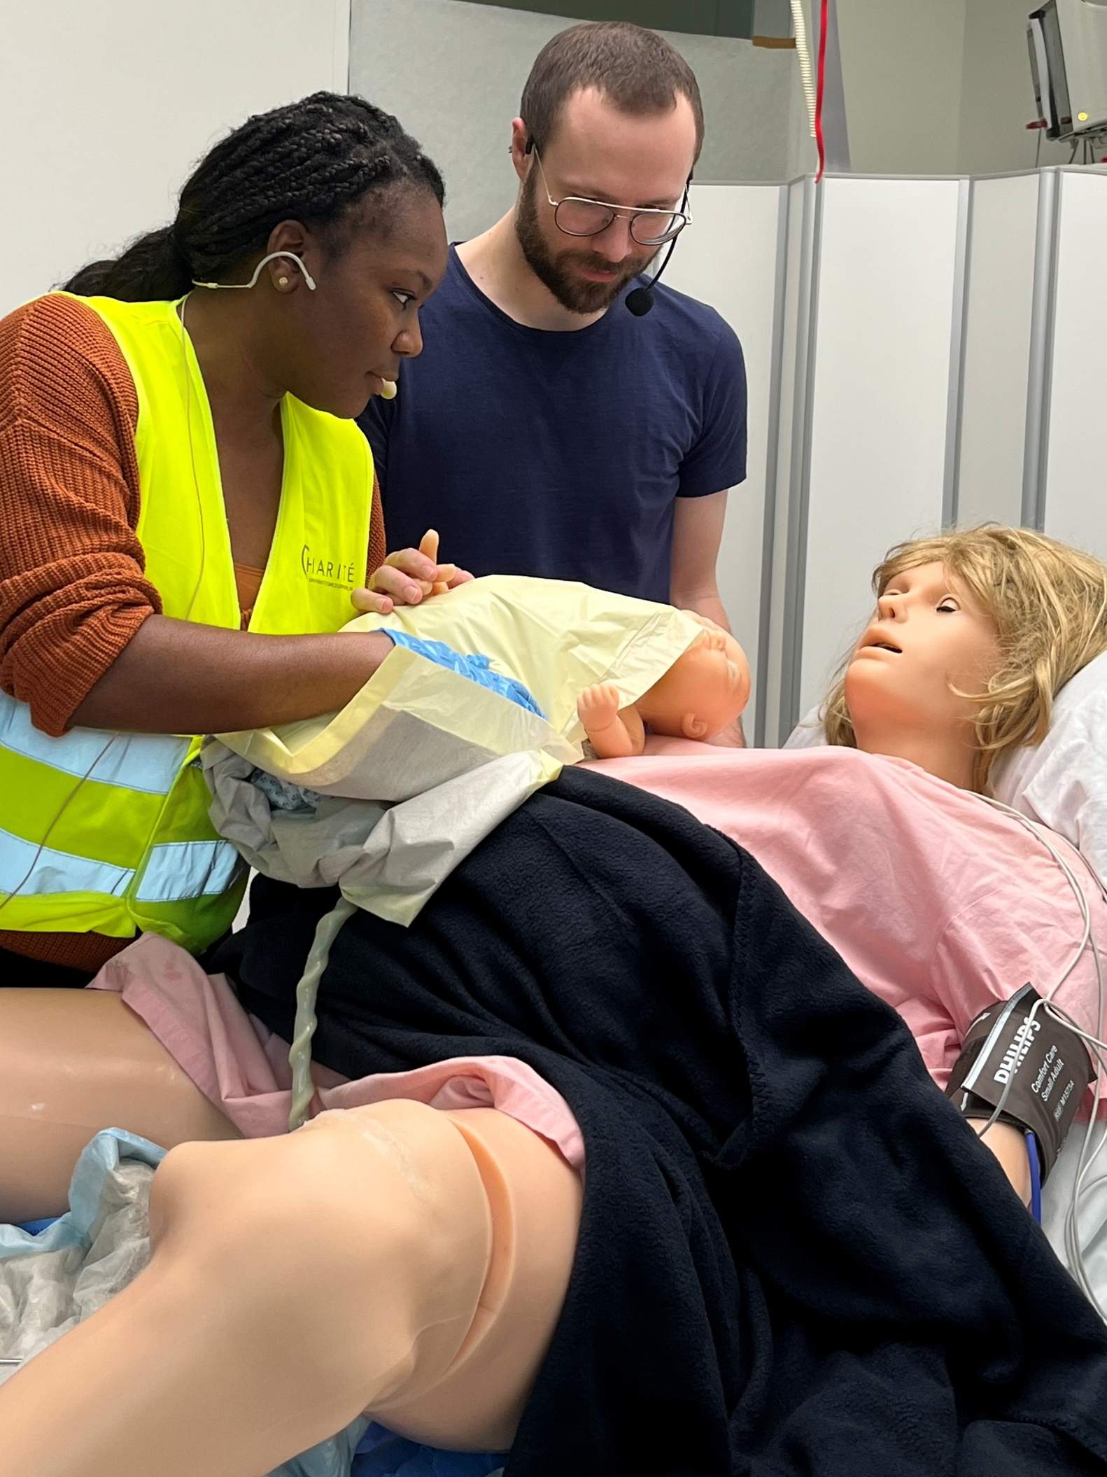
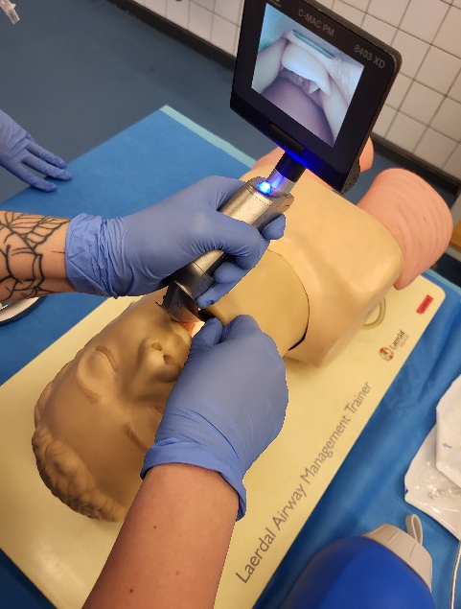
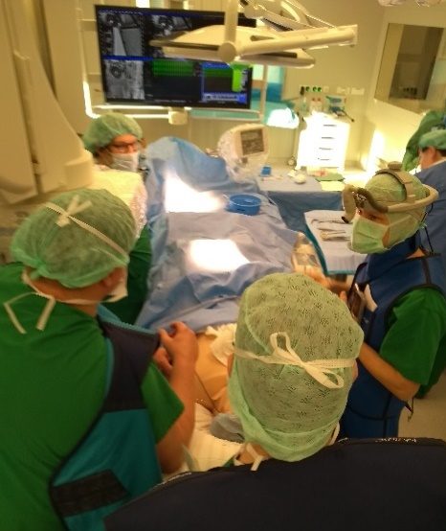
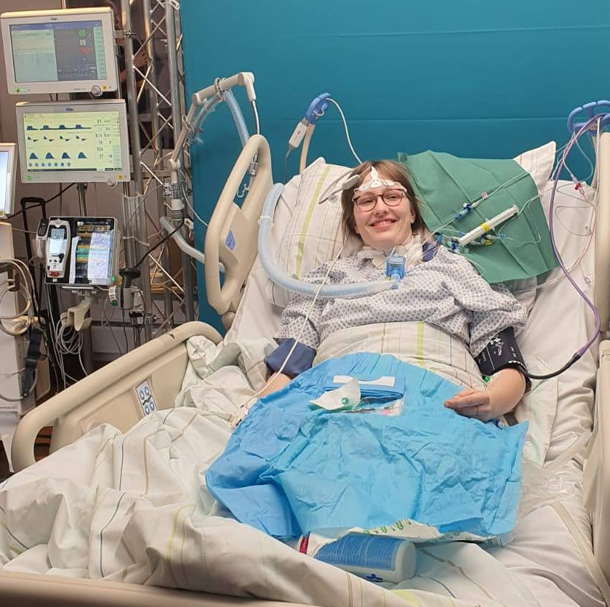
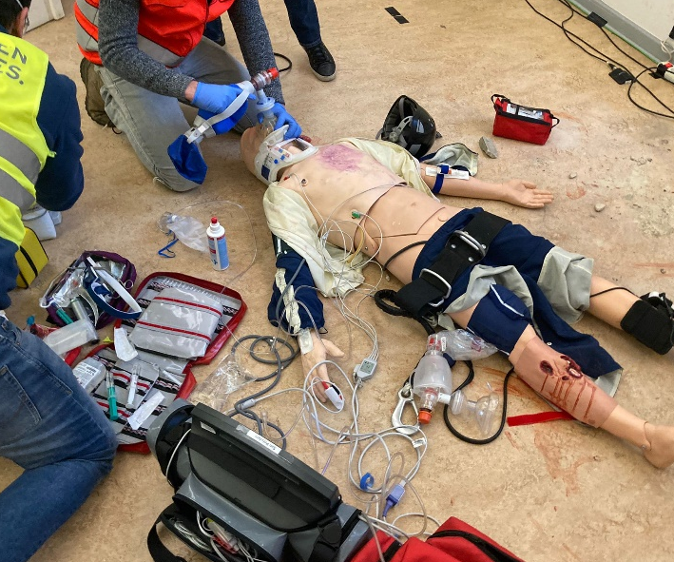
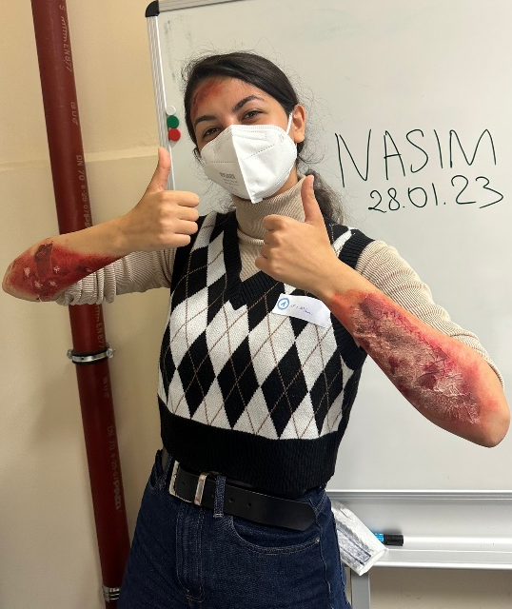
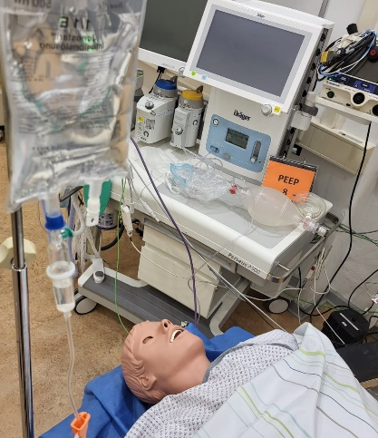

Sandbox Hospital

Slide 9
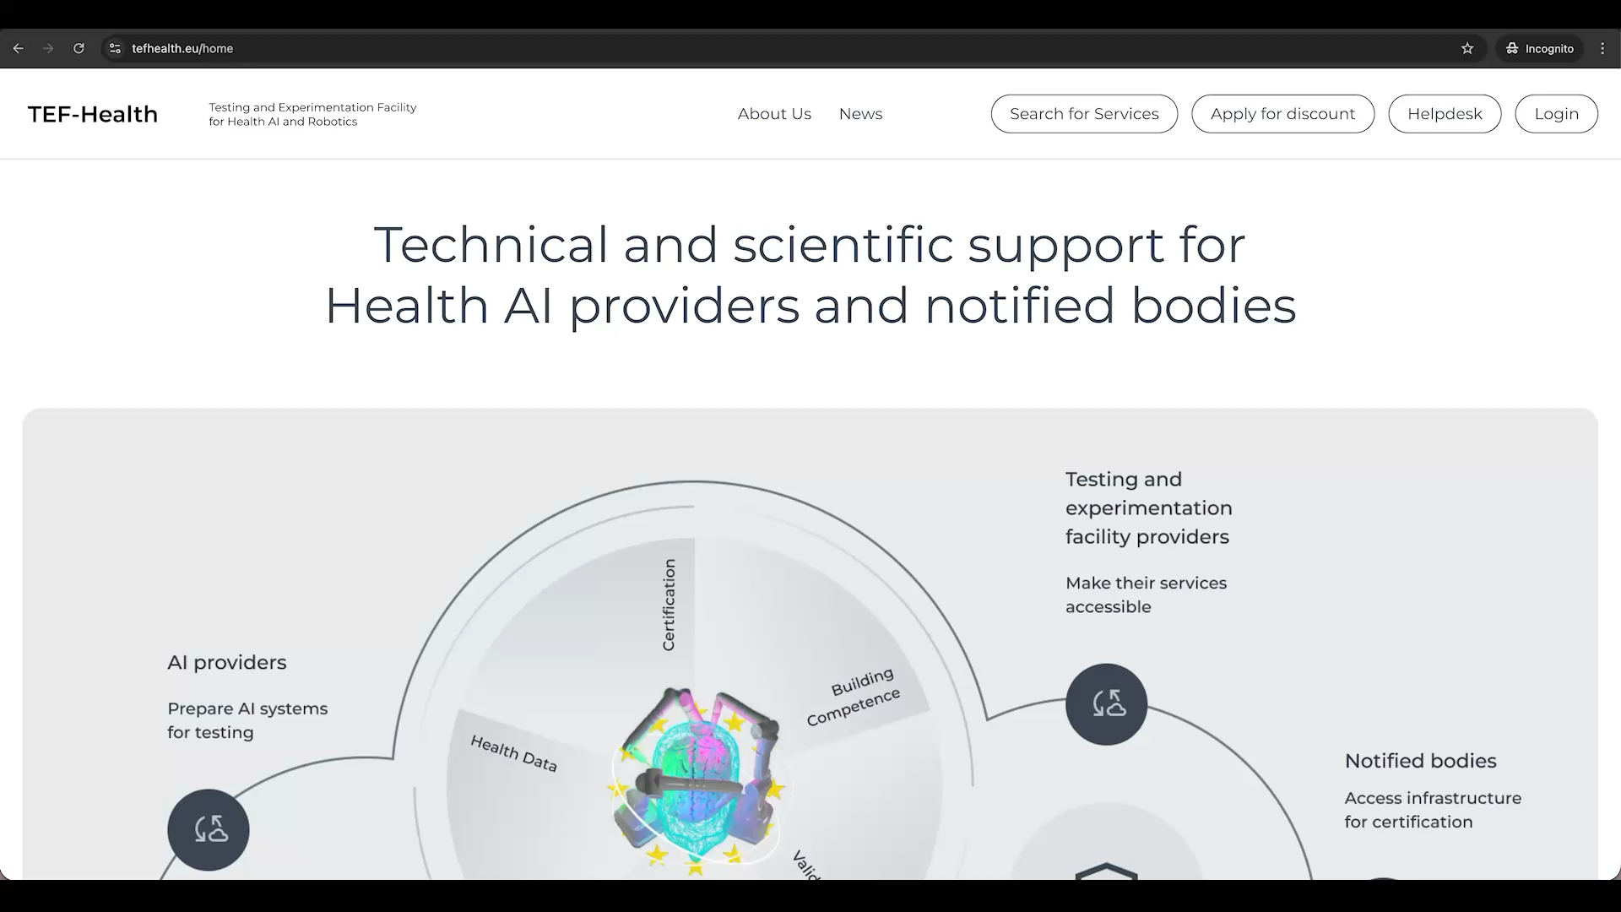
Guide for Applicants

Slide 10
Thank you
Tefhealth.eu

